Slide 1
LECTURE # 04 SITE ANALYSIS FACTORS

Slide 2
Site Analysis Factors
The analysis of the site and its environs includes various factors and features that affect it.
These factors influence final site selection and provide clues in establishing guidelines for later development.
Broadly these factors are categorized as:
1. Natural Factors
2. Biological Factors
3. Cultural/Aesthetic Factors

Slide 3
BIOLOGICAL FACTORS

Slide 4
Site Inventory Biological Factors
Categories | Attributes
Vegetation | Plant communities Specimen trees Exotic invasive species
Wildlife | Habitats for endangered or threatened species

Slide 5
1. Vegetation
For larger sites, careful study of types, patterns, location and distribution of plants help to understand the overall environment such as :
The site’s micro-climate (variations in local climate) including solar radiation, wind, humidity, air temperature.
Visual screening or exterior spaces, shade, buffer zones
The absorption or dispersion of sound, air quality
If a site is heavily wooded, a carefully planned thinning of the trees may open potential views.
Vegetation is a good indicator of soil and microclimate e.g. red maple trees grow in wet areas only.

Slide 6
Ecosystems
Ecosystems: Biotic or living elements ( plants and animals) combine in complex relationships with abiotic or nonliving elements (earth, water, air and sunlight) to produce ecosystems.
Broad classes include:
Terrestrial Ecosystems (land related)
Aquatic Ecosystems (water related)

Slide 7
Role of Vegetation
The relevance of Plant Materials in site planning is in their role in :
1. Climatic control 3. Architectural and Aesthetic Uses
Solar radiation
Wind
Precipitation
2. Environmental Engineering
Air pollution
Noise
Glare and reflection
Erosion control
View control
Space definition

Slide 8
Role of Vegetation Climatic Control
(a) Solar Radiation
Solar radiation is Earth’s source of light and heat. It warms the earth’s surface, is reflected by paving and other objects, and produces glare.
Trees are one of the best controls for solar radiation because:
they block or filter sunlight;
they cool the air under their canopies providing natural air conditioning;
Scientists have recorded that with an air temperature of 84° F, surface temp of a concrete paving was 108°, while surface temp under shade trees were 20° lower.

Slide 9
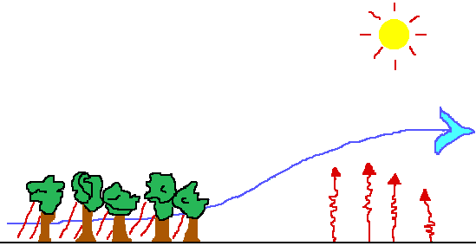
Role of Vegetation Climatic Control
(b) Wind
Wind helps to control temperature. When winds are of low velocity, they may be pleasant, but when velocity increases, may cause discomfort or damage.
Vegetation control winds by forming barriers by guiding and filtering the flow.

Slide 10
Role of Vegetation Climatic Control
(c) Precipitation
Plants help to control precipitation reaching the ground.
By intercepting rain and slowing it down, they aid in moisture retention, and in the prevention of soil erosion.
They also help soil retain water by providing shade, or protection from the wind, or by water shedding function of trees’ roots.

Slide 11
Role of Vegetation Environmental Engineering
(a) Air Purification
Plants clean air through the process of photosynthesis where they use up carbon dioxide emissions of cars and trucks and in the process release oxygen in the air.
Trees also help filter out other pollutants, i.e. sulfur dioxide, dust, pollen, and smoke.

Slide 12
Role of Vegetation Environmental Engineering
(b) Noise
The sound level of normal conversation is about 60 decibels; a plane taking off produces 120 decibels at a distance of 200 ft.
Sound energy usually spreads out and dissipates in transmission. Sound waves can be absorbed, reflected or deflected.
Plants absorb sound waves through their leaves, branches, twigs, especially those with thick fleshy leaves and thin petioles
Tree trunks deflect sounds and it has been estimated that a 100 ft. depth of forest can reduce sound by 21 decibels.

Slide 13
Role of Vegetation Environmental Engineering
(c) Glare and Reflection
Plants reduce glare and reflection caused by sunlight.
A light source received directly produces primary glare while reflected light is secondary glare.
Plants may be used to filter or block glare by use of plants with the appropriate size, shape, and foliage density.

Slide 14
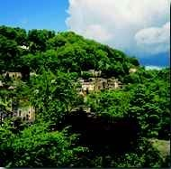
Role of Vegetation Environmental Engineering
(d) Erosion Control
Plants are a primary means of preventing erosion from storm water runoff and of controlling erosion during construction.
Erosion is also minimized by the plants action of intercepting rain, decreasing splash, and increased water absorption.
Vegetation with extensive root systems imparts stability to slopes.

Slide 15
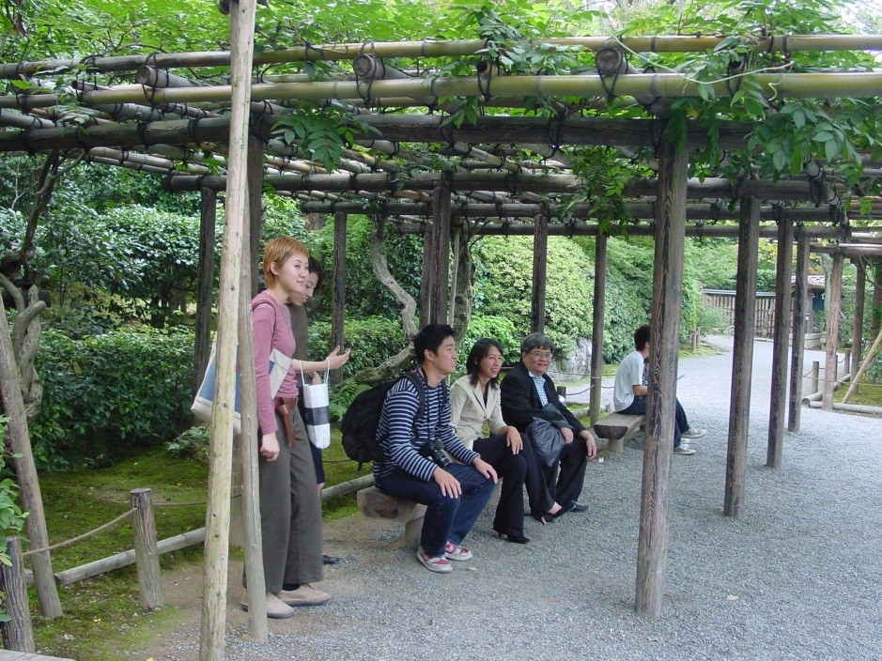
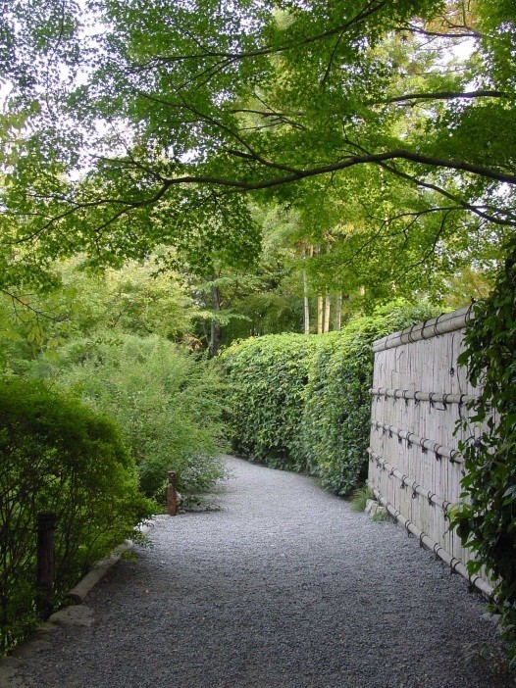
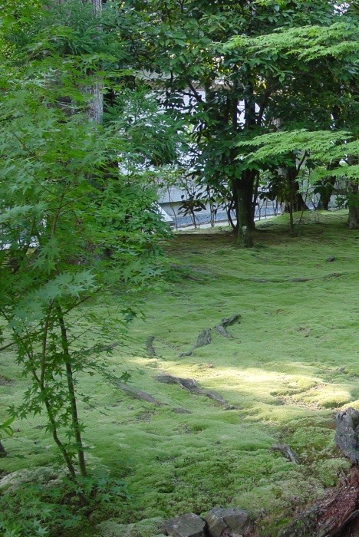
Role of Vegetation Architectural and Aesthetic Uses
(a) Space Definition
Plants can help in several ways:
as wall elements to form outdoor spaces,
as canopies to provide shade, or
as ground covers to provide color and texture on the base plane.

Slide 16
Role of Vegetation Architectural and Aesthetic Uses
(b) View Control
While trees and shrubs can screen out objectionable views, they can also provide backdrops for sculpture and fountains.
Additionally, they may provide filtered views of buildings or spaces, or frame a view, maximizing its effect.

Slide 17
2. Wildlife
Wildlife relates closely to habitats provided by plant communities. The three groups of habitat elements essential to the different species of wildlife are:
Openland Wildlife – includes birds and mammals commonly associated with crop fields, meadows, pastures, and non-forested lands.
Woodland Wildlife – includes birds and mammals associated with grasses, plants and shrubs usually wooded areas.
Wetland Wildlife –include birds and mammals associated with wetland food plants, floating aquatic plants, shallow water developments, etc.

Slide 18
Important Considerations
Wildlife is an important consideration for choosing the sites for park ot recreational areas.
Wildlife adds color, form, and movement to the landscape.
Existing wooded areas inhabited by wildlife may be prevented as parkland, along with residential subdivisions.

